Slide 1

Project 2 : Cellular response to drug perturbations
Ann- Sophie Kröll, Jana Braunger & Anna Münch
Supervisor: Nicolàs Palacio-Escat and Javier Perales-Patón
Tutor: Julia Rühle - 15.05.2019

Slide 2

NCI Transcriptional Pharmacodynamics Workbench
NCI-60-Cell line
12,704 genes
2 concentrations ( c_{max} , GI₅₀)
15 drugs → Erlotinib
Comparison untreated and treated transcriptional expression

Slide 3

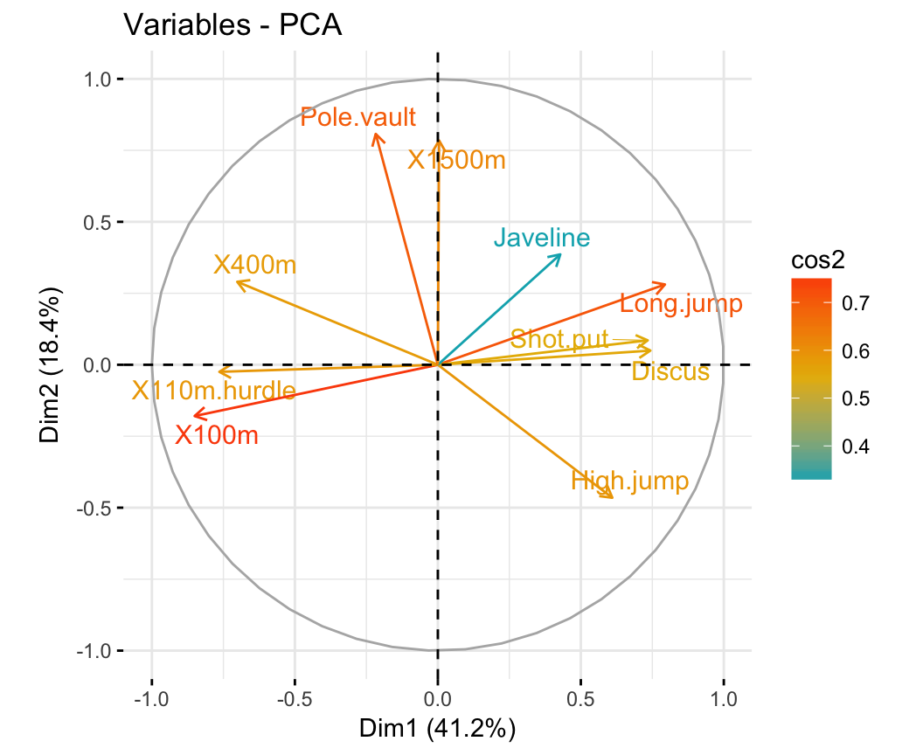
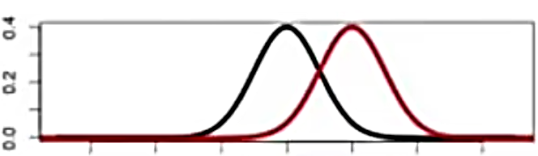
Broad analysis
Expression profiles: density plots and box plots
treated vs. untreated
Down- and upregulated genes separately
PCA: cell line treated with all drugs
which drug has most influence on FC?

Slide 4
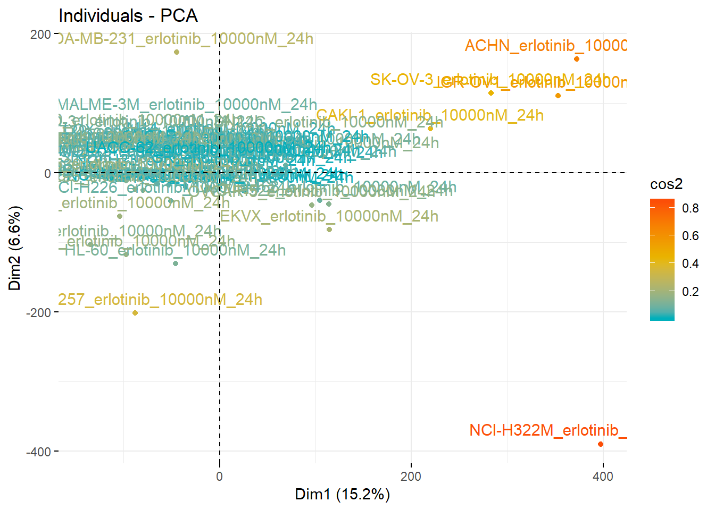
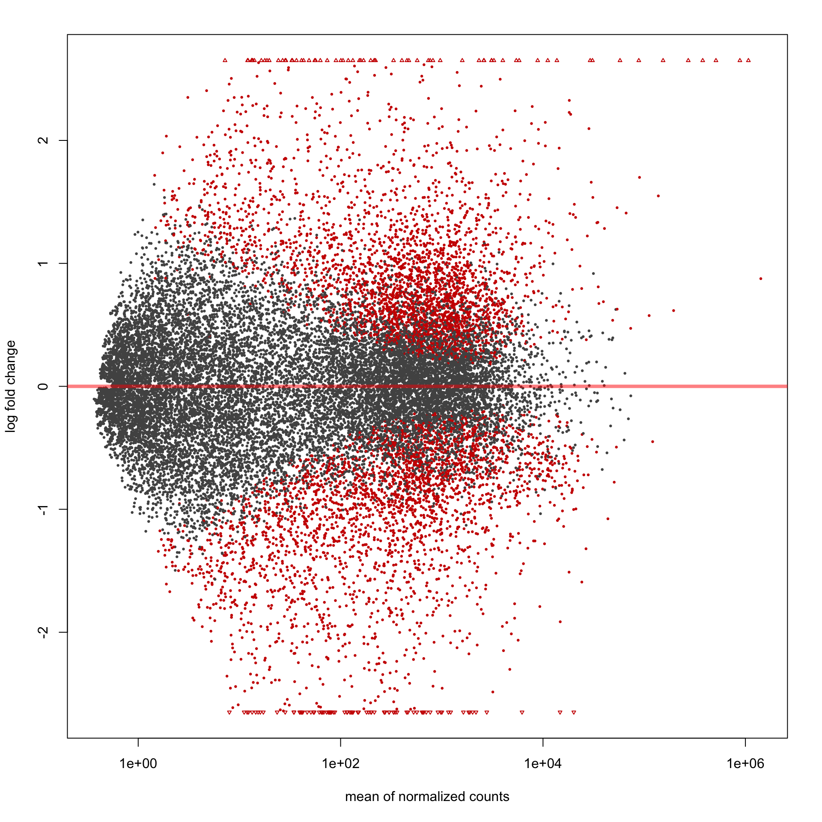
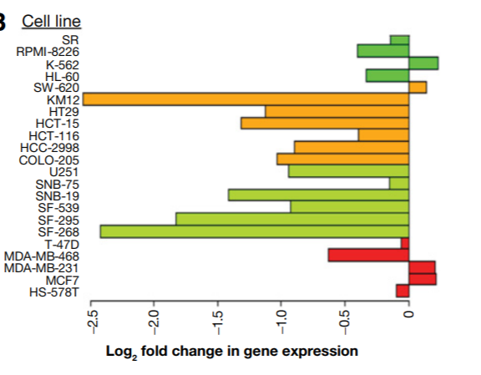
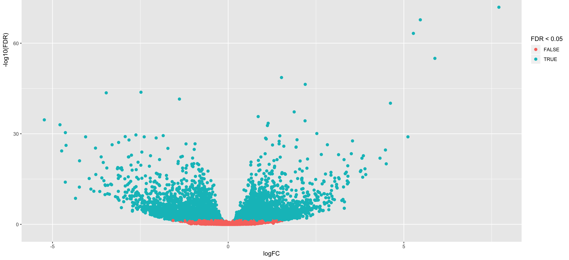
1. Milestone – Which genes and cell lines are most regulated by erlotinib?
Calculate FC
Cell lines:
Greatest variance in FC
Via PCA
Genes:
MA plot (of one cell line)
Volcano plot (FC against FDR)
Single gene response plot
Notes:
Differences between cell lines are more relevant to expression than drug treatment in PCA -> Treated (logarithmic data) - untreated (logarithmic data)
three most regulated genes
for 15 cell lines and colour the cancer type

Slide 5

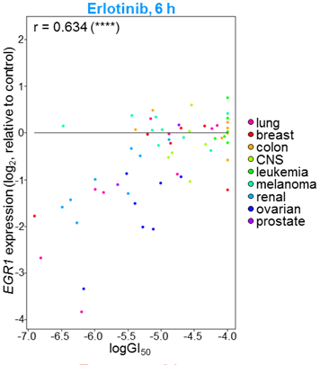
2. Milestone – Does the fold change correlate with cell growth inhibition?
Calculate the median of gene expression changes of the most influenced cell lines
Paired t-test: Wilcoxon signed rank test
Pearson Correlation with FC and GI50
→ linear regression
→ compare with 6h timepoint (Fig. S2)

Slide 6
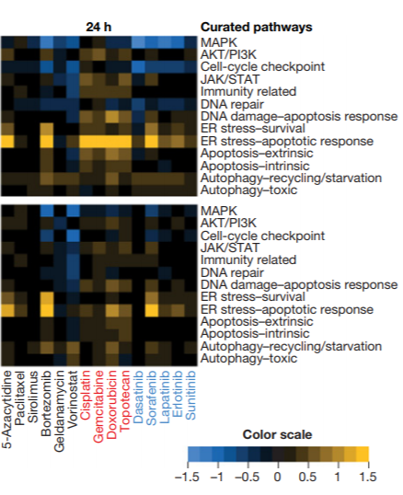
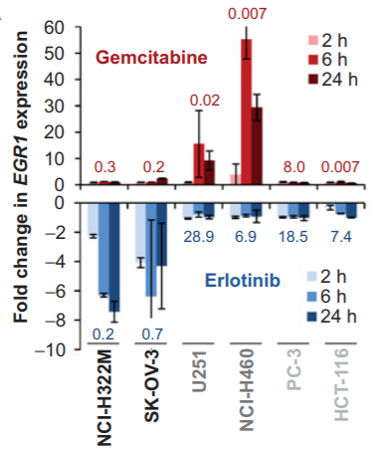
3. Milestone – Which cellular pathway’s are influenced by erlotinib?
PROGENy or NCI (Table S2)
→ affected cellular pathways
Heatmap: cell-lines vs. pathways
(median of FC of relevant genes)
Comparison with other drugs
15 Cell lines

Slide 7

Timeline
12 Weeks
with 2 weeks for each mile stone
4 weeks at the end to interpret the data and come up with future investigations, which could provide novel insight

